Slide 1
Tumor Fraction
Xiang Li

Slide 2
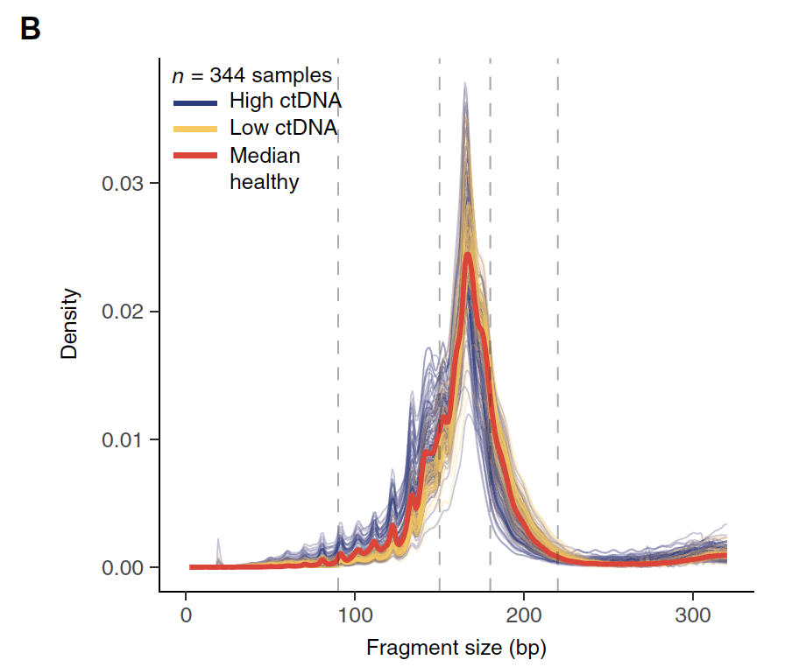
Background
Hypothesis:
1. Differences in fragment lengths of circulating DNA could be exploited to enhance sensitivity for detecting the presence of ctDNA and for noninvasive genomic analysis of cancer.
2. Fragment size analysis and selective sequencing of specific fragment sizes can boost ctDNA detection and could complement or provide an alternative to deeper sequencing of cfDNA
Ref: Enhanced detection of circulating tumor DNA by fragment size analysis. 2016 SCIENCE TRANSLATIONAL MEDICINE

Slide 3
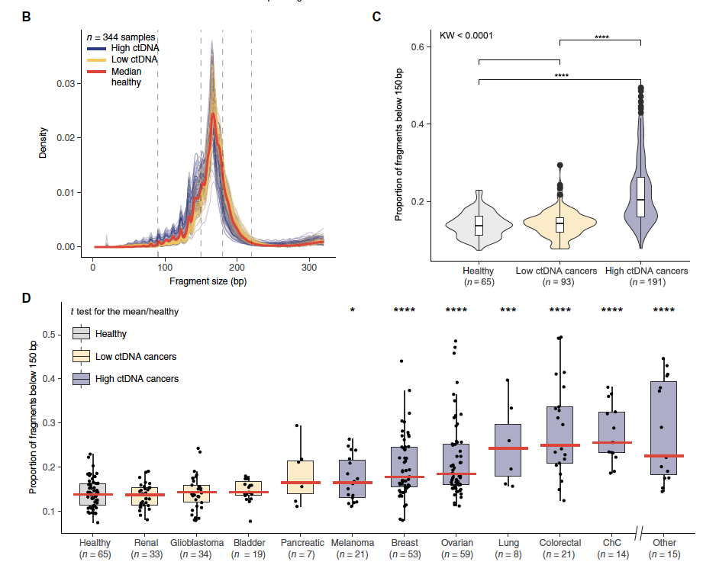

Slide 4
Plan (06/29/2021):
Generate Feature (Fragment Size):
(Done)Get a table of molecules fragment size distribution.
https://github.com/guardant/data_science/blob/master/02_DEVELOPMENT/210503_FUSION_FRAGMENTOMICS/00_prepareData.R
Now working with test data, considering switch to full data set Soon.
Run R script (row178), Where:
wg_bed_file: 29675 rows https://raw.githubusercontent.com/guardant/ghpipeline/master/parameter_sets/Omni/v1.0/Omni1.0_probes.bed?token=AHUW5C2QMF7TPB3PCJFSHEDA4R6ZC
reference_file = /ghess/shared/ref/genome.fa. (hg19)
max_size = 500 (molecule max size)
folder with molecule fiules /ghds/groups/bioinformatics/02_DEVELOPMENT/210503_FUSION_FRAGMENTOMICS/clinical_samples/molecule_counts
Data dimension reduction
Working Path:
/ghds/groups/algorithms/projects/Study_Fragment_Size/
Need samples of tumor & non-tumor
Build Predictor

Slide 5
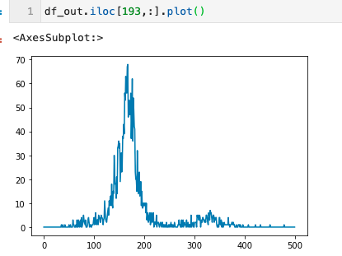
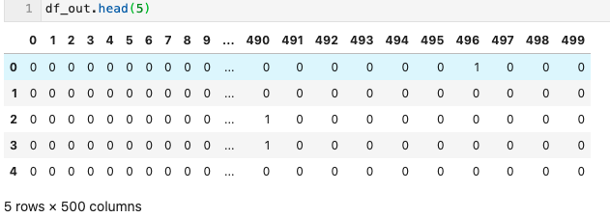
Fragment Size Distribution Test on A035043401.molecule_table.tsv
chrom | start | end | num_molecules | num_reads | mean_mapq | cg_count | bin_idx
1 | 156785323 | 156785748 | 1 | 1 | 60 | 233 | 0
1 | 156785323 | 156785752 | 1 | 2 | 60 | 236 | 0
1 | 156785323 | 156785921 | 1 | 1 | 60 | 340 | 0
1 | 156785324 | 156785765 | 1 | 1 | 60 | 242 | 0
1 | 156785349 | 156785745 | 1 | 1 | 60 | 217 | 0
1 | 156785349 | 156785879 | 1 | 1 | 60 | 301 | 0
1 | 156785351 | 156785720 | 1 | 2 | 60 | 201 | 0
1 | 156785351 | 156785761 | 1 | 2 | 60 | 226 | 0
1 | 156785365 | 156785708 | 1 | 2 | 60 | 188 | 0
From
Done

Slide 6
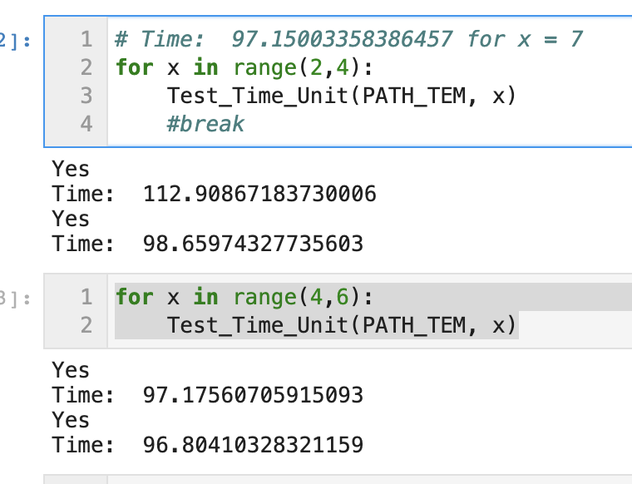
Chunksize: 10**3~10**5 no difference

Slide 7
Training Data(500 samples)
/ghds/groups/bioinformatics/02_DEVELOPMENT/200830_GHCNVWG_PIPELINE/results/210608_CLINICAL_SAMPLES_V0.5/processed_samples/List_of_testing_samples_4TF_training.210630.tsv
Column 'type' contains 2 entries:
TND (TF=0)
Clinical (TF > 0)

Slide 8
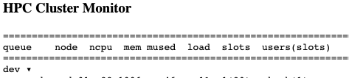
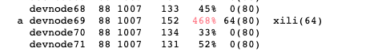
Records
Some update to share,
I solved the issues by generating these qsub *.sh through python.
And I ran 500 samples and get 491 results of molecule.table.tcv (around 700GBs). (Will take a look at the rest 9 samples and why it failed. Later. )
Then I apply the python module to extract Fragment Size distribution. (Now received around 200 samples. At least I can start to do the following predictor building. )
Some Issues here about the over load of HPC. (I received more than 400% in the load columns from HPC Cluster Monitor, then I qdel the job.)

Slide 9
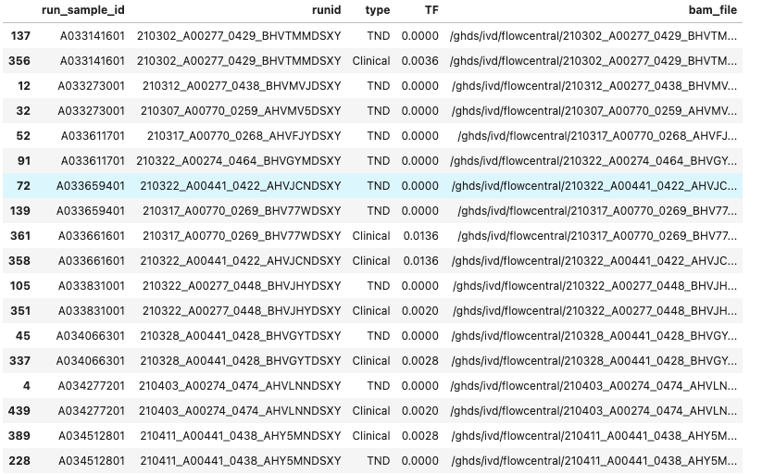
Samples Failed (484 samples succussed)
5 samples with issues:
'A034066301', 'A034512801', 'A033141601', 'A033831001', 'A034277201'
Notes:
5 samples with issues:
'A034066301', 'A034512801', 'A033141601', 'A033831001', 'A034277201'

Slide 10
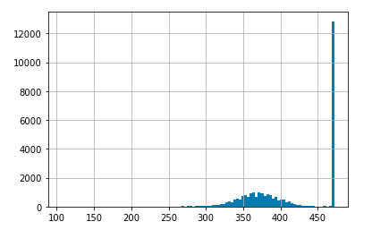
For Probes How many samples(out of 472) have a fragment count
ghcnv_qc table in ghdb
Column diversity in ghcnv_qc > 700
#_probes
#_samples (max 472)
For example, there are 12,758 probes that
has counts from 472 samples.

Slide 11
Predictor in tensorflow
pip3 install --user --upgrade tensorflow # install in $HOME
python3 -c "import tensorflow as tf; print(tf.reduce_sum(tf.random.normal([1000, 1000])))"
Notes:
https://www.tensorflow.org/install/pip#system-install

Slide 12
Treat data like 480 images 12,758*500
we load the training data set and testing data set in the variables (x_train,y_train) and (x_test,y_test)
Flatten the pixel values or features into a 1-D array of size 12,758*500 using the reshape method. We also normalize the pixel intensities to make sure their values are between 0 to 1.

Slide 13
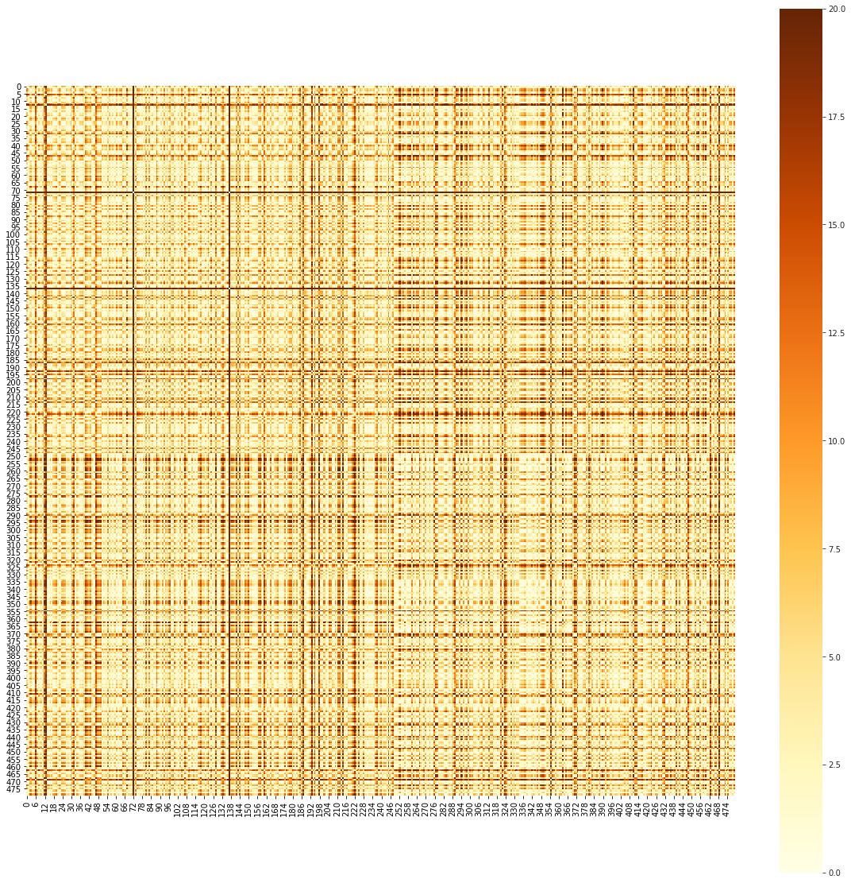
Aggregated ~12K probes t test for each sample
0-500 bps
TND
-log_10 (pvalue)
TF

Slide 14
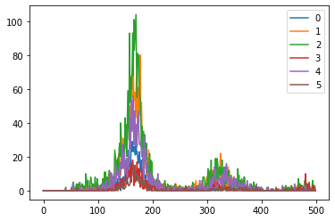
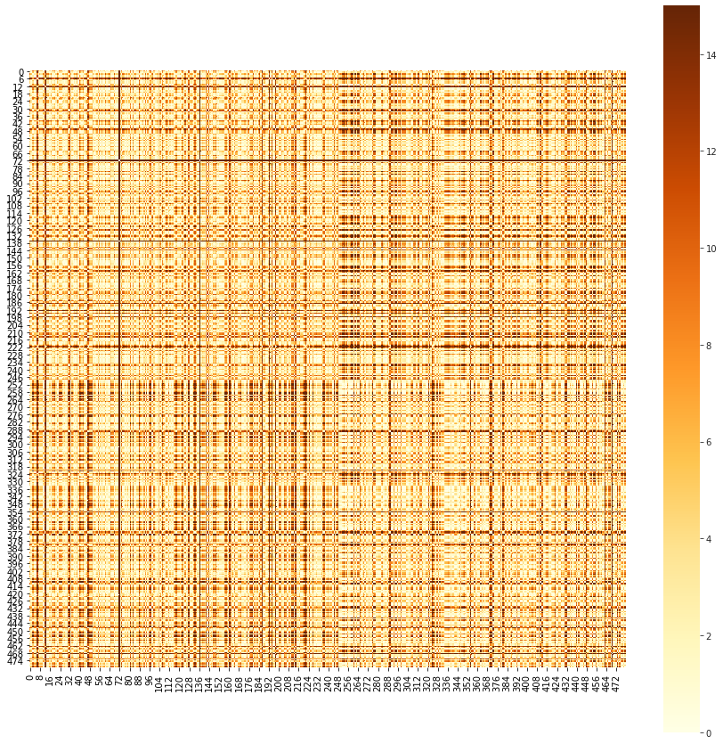
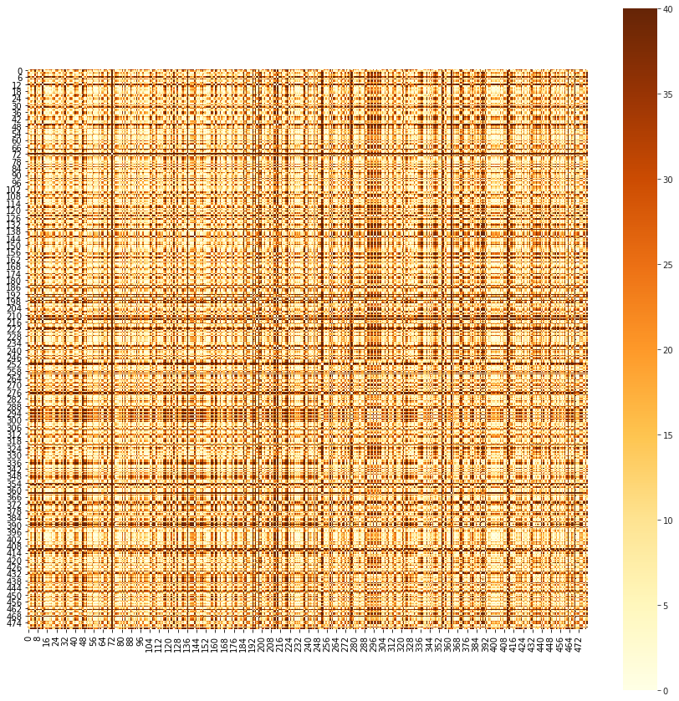
Aggregated ~12K probes t test for each sample
50-250 bps
250-400 bps
250-400 bps

Slide 15
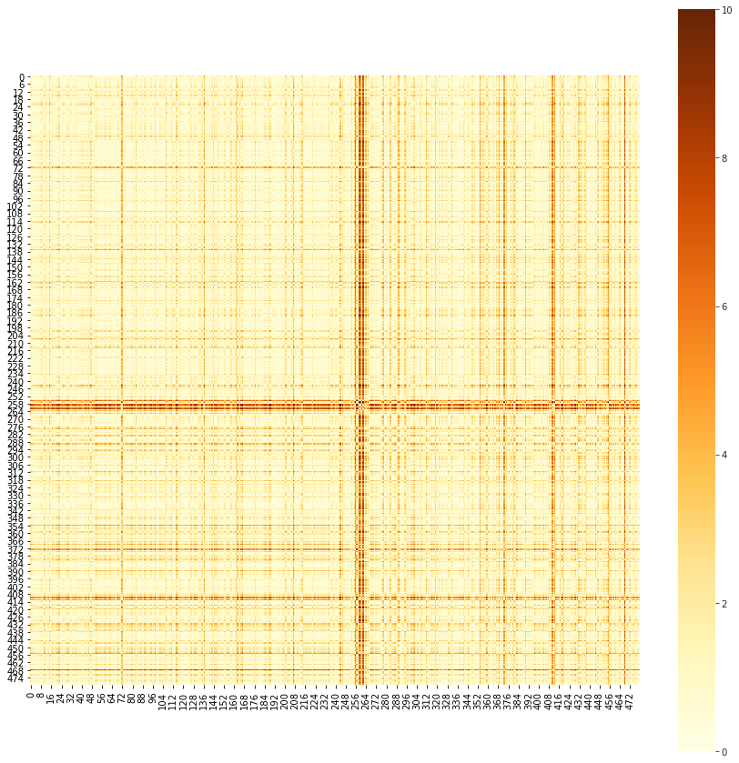
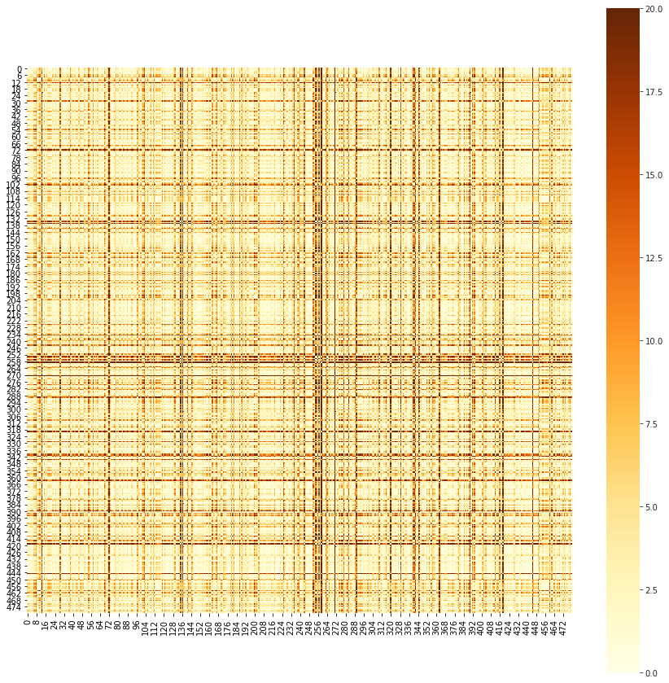
Aggregated ~12K probes MWU test for each sample
50-250 bps
250-400 bps
Notes:
https://docs.scipy.org/doc/scipy/reference/generated/scipy.stats.mannwhitneyu.html
The Mann-Whitney U test is a nonparametric test of the null hypothesis that the distribution underlying sample x is the same as the distribution underlying sample y. It is often used as a test of of difference in location between distributions.

Slide 16
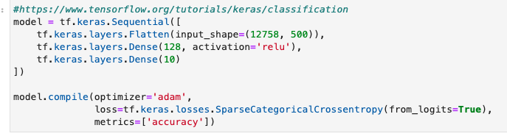
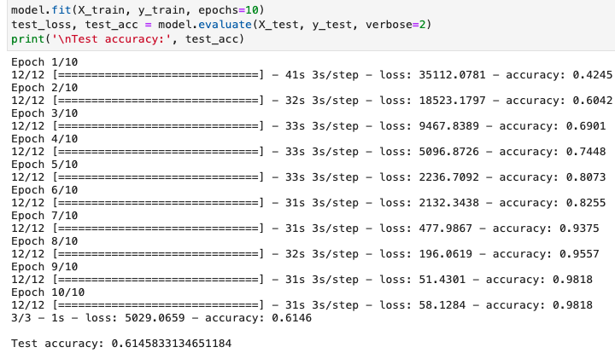
Brutal force DL, overfitting, 61~73% accuracy

Slide 17
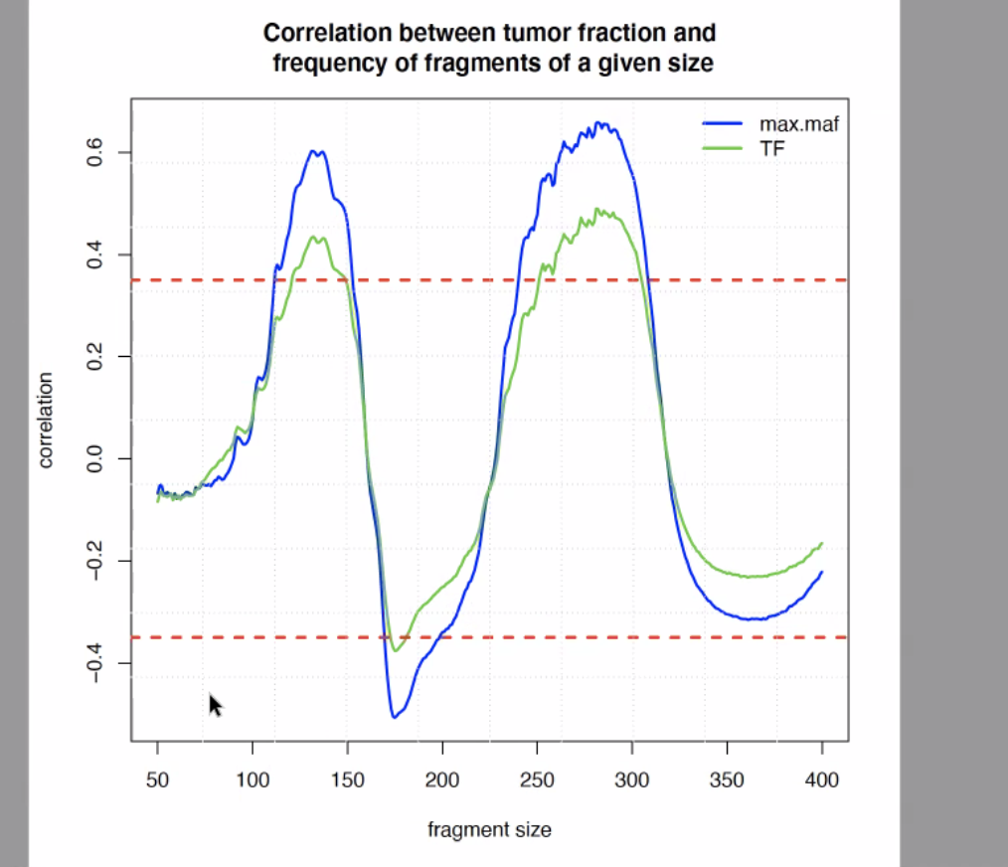
Predicted TF vs MAF

Slide 18
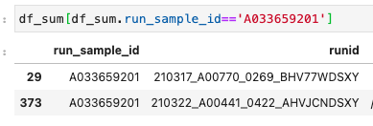
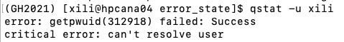
Status: Solved
/ghds/groups/bioinformatics/02_DEVELOPMENT/200830_GHCNVWG_PIPELINE/results/210608_CLINICAL_SAMPLES_V0.5/processed_samples/List_of_samples_4TF_testing.210708.tsv
Repeatedly failed sample:
A033638502
A033570601
After submitted this job, my authorization to the cluster was shutdown for 1 min.

Slide 19
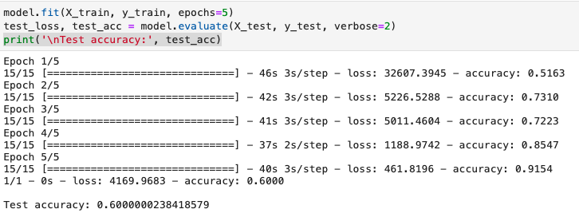
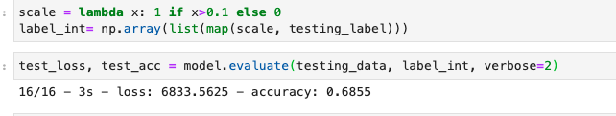
Classification Performance
Notes:
https://stackoverflow.com/questions/45528285/cnn-image-recognition-with-regression-output-on-tensorflow

Slide 20
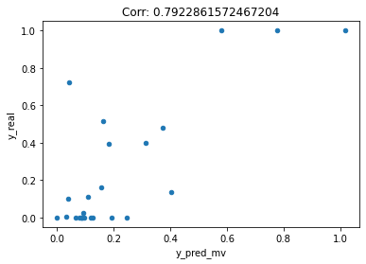
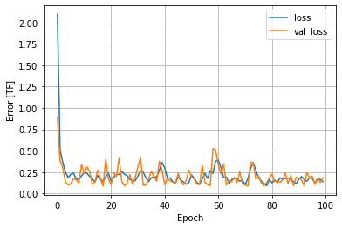
Regression Performance on training data(480)

Slide 21
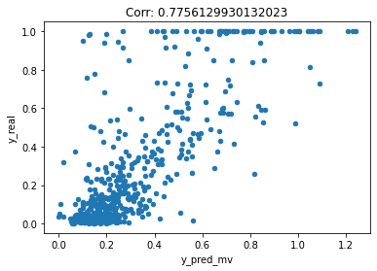
Regression Performance on testing data (496)
Notes:
Probes-level fragment size distribution

Slide 23
Plan (06/29/2021):
Generate Feature (Fragment Size):
(Done)Get a table of molecules fragment size distribution.
https://github.com/guardant/data_science/blob/master/02_DEVELOPMENT/210503_FUSION_FRAGMENTOMICS/00_prepareData.R
Now working with test data, considering switch to full data set Soon.
Run R script (row178), Where:
wg_bed_file: 29675 rows https://raw.githubusercontent.com/guardant/ghpipeline/master/parameter_sets/Omni/v1.0/Omni1.0_probes.bed?token=AHUW5C2QMF7TPB3PCJFSHEDA4R6ZC
reference_file = /ghess/shared/ref/genome.fa. (hg19)
max_size = 500 (molecule max size)
folder with molecule fiules /ghds/groups/bioinformatics/02_DEVELOPMENT/210503_FUSION_FRAGMENTOMICS/clinical_samples/molecule_counts
Data dimension reduction
Working Path:
/ghds/groups/algorithms/projects/Study_Fragment_Size/
Need samples of tumor & non-tumor
Build Predictor

Slide 24
Background
Hypothesis:
1. Differences in fragment lengths of circulating DNA could be exploited to enhance sensitivity for detecting the presence of ctDNA and for noninvasive genomic analysis of cancer.
2. Fragment size analysis and selective sequencing of specific fragment sizes can boost ctDNA detection and could complement or provide an alternative to deeper sequencing of cfDNA
Ref: Mouliere, Florent, et al. "Enhanced detection of circulating tumor DNA by fragment size analysis." Science translational medicine 10.466 (2018).

Slide 25
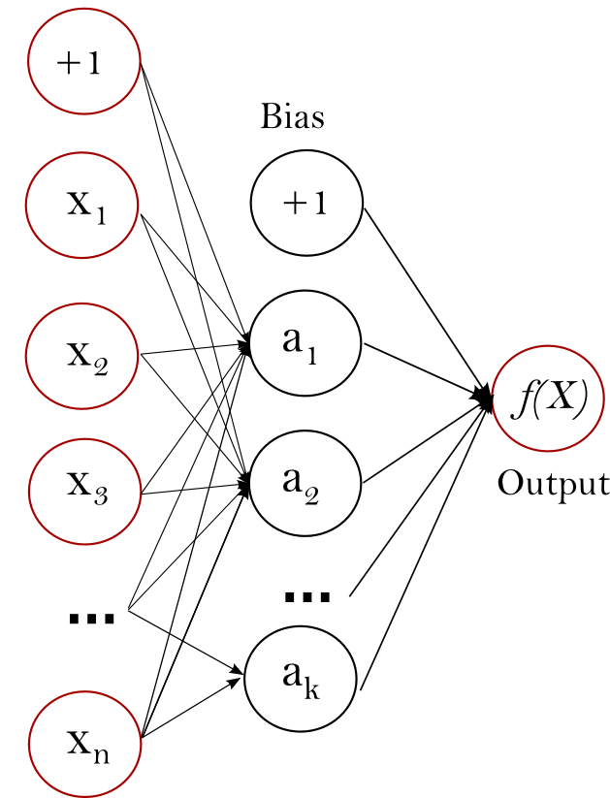

Brutal-force DNN setup for test scheme
Predictor
461 Training Samples
496 Testing Samples
12758*500
64
1
= 12758 *

Slide 26
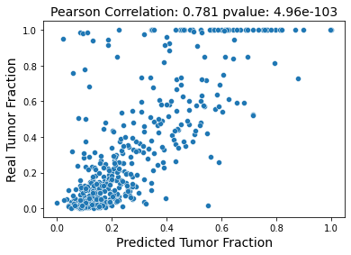
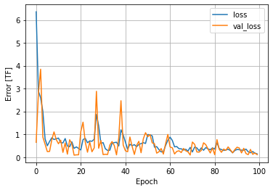
Regression Performance on testing data (496)
Great thanks to @Catalin and my mentor @Ravi for their help and guidance.
And fruitful discussion from @Alex and @Hao

